Slide 1
The hard problem of signaling
Craig Weinberg, MCSE, CCEA

Slide 2
overview
Statement of the Problem: Machines seem to lack our sense.
Auto-Correct Failures, OCR Artifacts
Gathering Information:
Adversarial Images vs Natural Misunderstandings
What is and is not a signal?
How does a non-signal become a signal?
Hypothesis:
We presume that signals are physical or logical, but they are not.
Meta-Hypothesis: Presumptions are magnified by folk language and scientific mislabeling
Implications
Philosophy, Computer Science, Logic, Neuroscience, AGI

Slide 3

STATEMENT of the problem
Auto-Correct Failures
It’s not only that predictive text often fails, it’s that the nature of the failure exposes a lack of understanding. The prediction or even guessing is an illusion. The reality is a bottom-up mechanism derived from statistics on the frequency of syntactic elements.
Notes:
Siri, Alexa

Slide 4
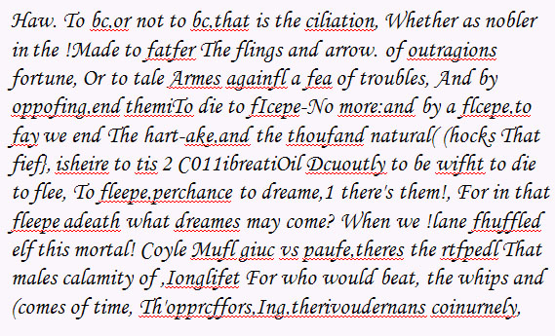
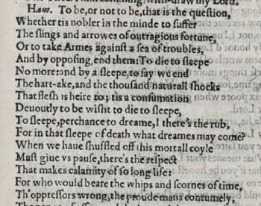
STATEMENT of the problem
OCR Artifacts

Slide 5
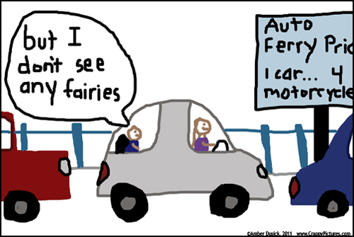
Gathering information
Natural Misunderstandings
When children misunderstand language there is no illusion of understanding exposed.
Real understanding is a top-down, semantically driven condition which derives from experience and imagination.
Notes:
Natural guesses are drawn from experience and imagination.
Fiction and fact are less distinct for children.

Slide 6
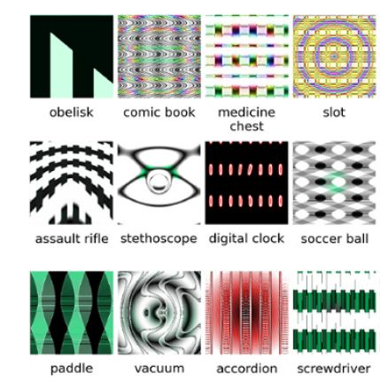
Gathering information
http://www.evolvingai.org/fooling
Adversarial Images
Fooling Deep Neural Networks is easier than it would be if machines were recognizing images visually and consciously.
Notes:
Common feature of the failures = Uncanny quality
“Does not compute.”

Slide 7
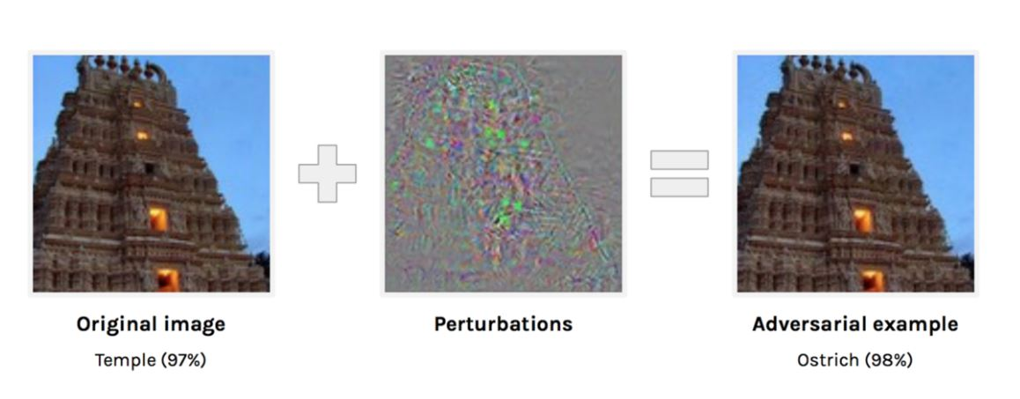
Gathering information
Adversarial Images That Fool Computers, But Not Humans
Notes:
Common feature of the failures = Uncanny quality
“Does not compute.”

Slide 8

Gathering information
What is a signal?
Phenomena which trigger detection and interpretation
as referring to other than itself.
What is not a signal?
Phenomena whose presence or absence are not detected.
Presences or absences which are detected but not interpreted (noise).
Notes:
Definition by language vs definition by concept. We don’t care about formalizing the definition of a word, but rather understanding a natural phenomenon.
Conceptually, a signal is part of a sense experience which can attract attention and invite sense-making associations. A local sensation which refers to non-local sensations, ideas, emotions.

Slide 9
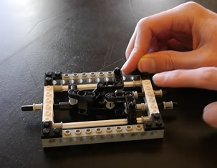
Gathering information
How Does a Non-Signal Become a Signal?
“The position of a pin represents the state of a bit. True or false, one or zero.”
In other words:
Making believe. Pretending.
- Lego Logic Gates – The Half-Adder
Notes:
Machines bits are stop/go, not 1/0 or T/F

Slide 10
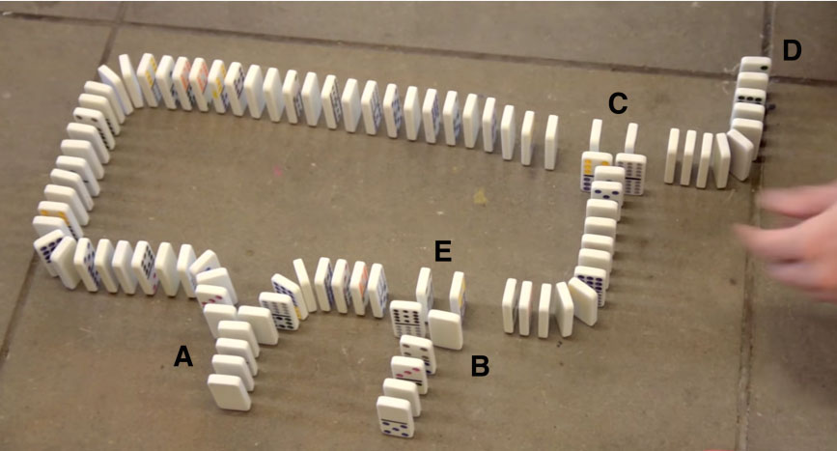
Hypothesis
Cause and Effect Chains are Not Signals
The 10,000 Domino Computer https://www.youtube.com/watch?time_continue=6&v=OpLU__bhu2w
Components need not even add up to be a “chain”. D is not aware of A.
Notes:
A has no connection to D

Slide 11
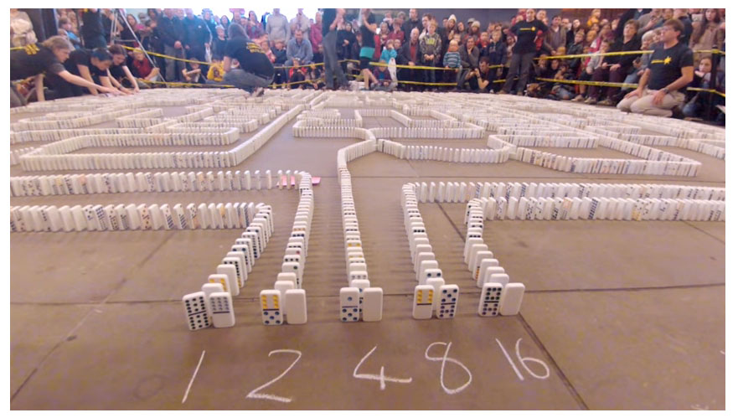
hypothesis

Slide 12
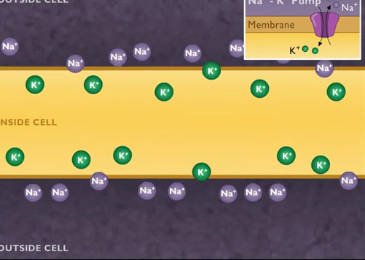
Gathering information
How Does a Cell Produce a Signal?
“A nerve impulse begins when a stimulus disturbs the plasma membrane on a dendrite, causing sodium channels to open. Sodium ions flow into the cell...”
The Nerve Impulse [HD Animation]
Notes:
A nerve impulse begins with a stimulus.

Slide 13
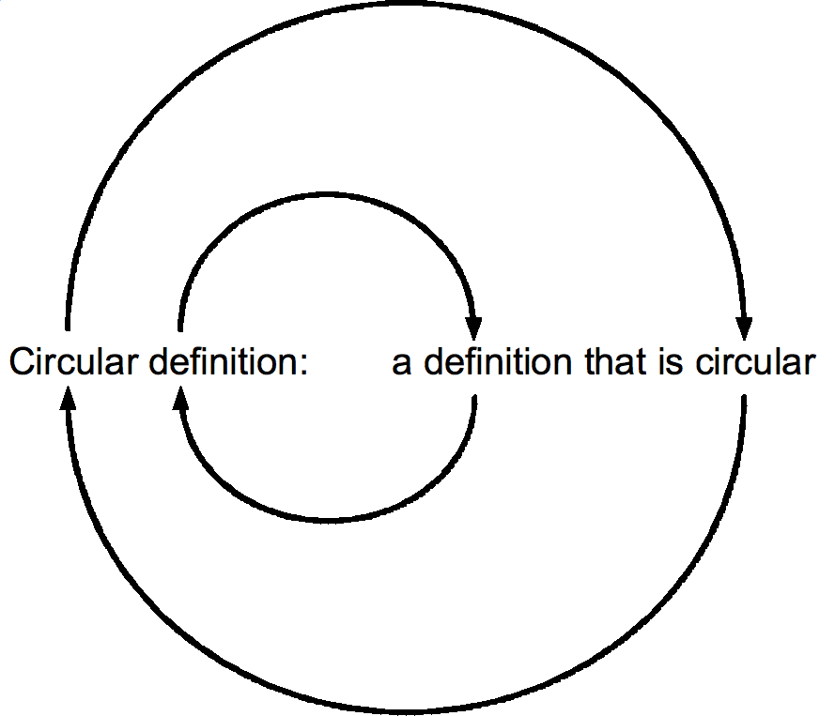
Gathering information
What is a Stimulus?
“something that rouses or incites to activity” Merriam-Webster
“Something that can elicit or evoke a physiological response in a cell, a tissue, or an organism.” Dictionary.com
Notes:
A stimulus is anything that causes stimulation.

Slide 14
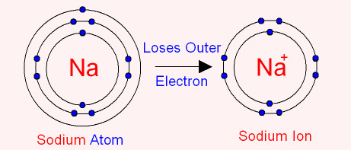
Meta-hypothesis
Folk Language smuggles in Anthropomorphism
“Negative ions like to gain electrons.”
“Electric charge is the physical property of matter that causes it to experience a force when placed in an electromagnetic field. “ - Electric charge - Wikipedia
Notes:
“Like to gain”
“matter ‘experiences’ force”

Slide 15
Meta-hypothesis
Scientific Language can Smuggle in False Confidence
What they are:
Atoms with 11 protons and 10 electrons.
What they do:
Move toward or away from other atoms.
Why they do that:
We don’t know. We call it a ‘force’.
Sodium Ions
Notes:
Calling an atom with more or less electrons than usual an “ion” conflates the structure with the behavior.

Slide 16
Meta-hypothesis
Scientific Language can Smuggle in False Confidence
Nerve Impulses
What they are:
Large numbers of atoms moving across a cell membrane.
What they do:
Cause other cell membranes to allow or prevent atoms from moving across them.
Why they do that:
Because they are accumulations of simpler force interactions.
Notes:
The nerve impulse is a pattern that is visible from a distance as changes in where molecules and atoms are moving within tissues and changing the shape of the tissues.

Slide 17
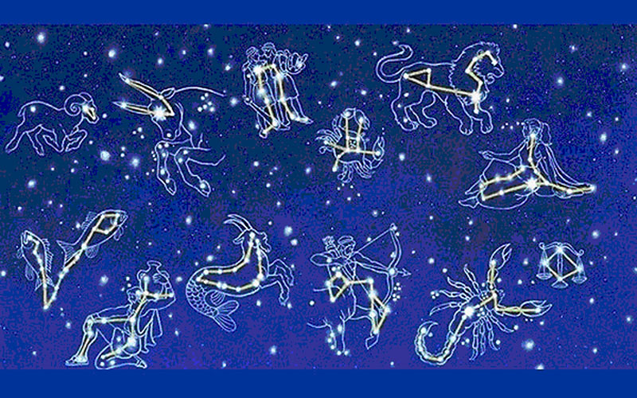
Hypothesis: SIGNALs are aesthetic pROJECTIONs
Notes:
Apophenia

Slide 18
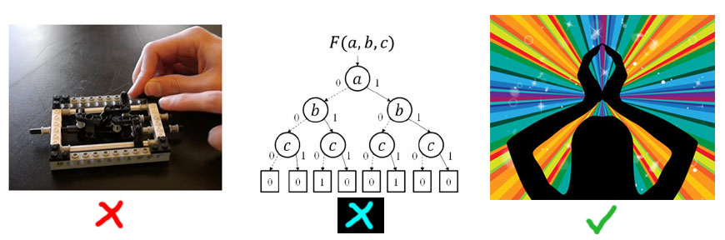
Do Signals Exist Physically, Logically, or Aesthetically?
general IMPLICATIONS

Slide 19
Do Signals Exist Physically, Logically, or Aesthetically?
general IMPLICATIONS
Notes:
Physical events logically require no sensitivity, reference, or signal. Physical causality is the result of objective physical forces.
If we define physics so weakly as to include phenomenal properties then there is no reason not to see those properties as more fundamental and interesting than physics itself
Logical processes take signaling for granted. Any appearances of phenomenal properties would be unexplainable and redundant since the states of the machines *are* the data.

Slide 20
The Hard Problem of Signaling
Physical events can be used to signal within a conscious experience, but physical events are not signals themselves.
If we say that physical events can be signals, then we are acknowledging that physics is intrinsically phenomenal.
The Explanatory Gap need not be limited to human consciousness, brains, or biology.
We cannot assume that awareness can or will scale up from micro states.
Philosophical implications
Notes:
Since physics is causally closed, and since physical causes and effects are due to the interaction of fundamental forces, not only could a physical world exist without signals, but by Occam’s Razor, we should assume that no physical world contains signals.

Slide 21
Modus Ponens and Modus Tollens Propositions
MP: "Since we are machines then if we are conscious, some machines must generate consciousness.“
MT: "Since machines have no reason or method to generate consciousness, then if we are conscious we must not be machines."
MP: “Since computers are more than the sum of their physical operations, Leibniz Mill and Searle’s Chinese Room are false arguments”.
MT: “Even though microelectronics and video screens make them seem to us like more than the sum of their physical operations, computers are no more than dominoes falling, and consciousness cannot emerge from them.”
Philosophical implications
Notes:
MP: We are machines, machines can be aware.
MT: We are aware, we are not machines.
MP: Computers are more than objects, Leibniz and Searle are wrong.
MT: Computers are no more than objects, complexity and speed change nothing relevant.
.

Slide 22
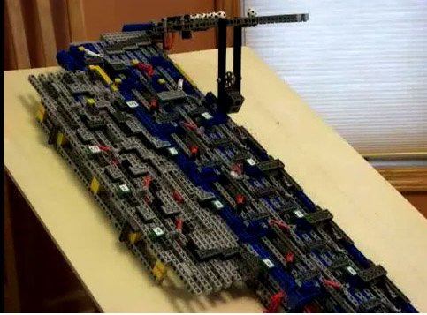
Computer Hardware
What they are:
Solid material objects with moving parts. Tangible geometric forms.
What they do:
Cause material changes by chain reactions of physical force.
Why they do it:
Because we build them to exploit physical conditions to satisfy our desires.
Computer SCIENCE IMPLICATIONS
Notes:
All computers can be built out of Legos. The “Data” *is* the position of the various levers.

Slide 23
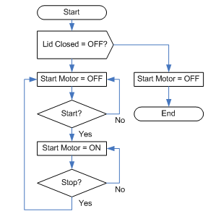
Logical Machines
What they are:
Abstract conceptual designs or programs.
What they do:
Formalize a description of a sequential process.
Why they do it:
Because we use them to clarify our thoughts and designs.
Computer SCIENCE IMPLICATIONS
Notes:
If physical machines are absolutely concrete and tangible, logical programs are absolutely intangible and abstract. Substance dualism. Software needs compiling.

Slide 24
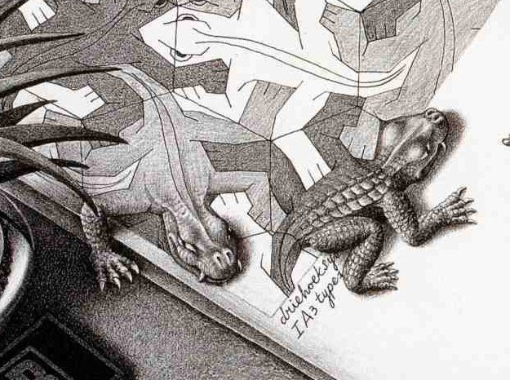
Can Logic Access Physical Locations?
Logical predicates are non-local, non-temporal abstractions.
Localizing abstractions requires sensory i/o and sense-making association.
Computation need not analogize. Mechanical execution requires only pre-logical causes and effects.
Logical IMPLICATIONS
Notes:
To the extent that logic exists, it exists as a timeless sense of sense-making. Logic helps us make sense of sense experience but it has no access to sense experience itself.

Slide 25
Can Signals Logically Exist?
Software assumes a capacity to input and output logical states. These states are axiomatic rather than sensations and affects.
IF X = Y THEN Z
not
IF X FEELS Y THEN MAYBE Z.
Logical IMPLICATIONS
Notes:
Feeling should not compute. State changes are assumed to be facts, and no detection is required.

Slide 26
Signaling Requires More Than Logic
Logic: X = X Identity is given axiomatically.
Signal: X➙ Y➙Y➙Z≅Q) Identity requires sense and sense-making.
X causes effect Y, which might cause Y to be detected as a signal Z to seem like quale Q.
Blowing air through a metal pipe (X) might cause the vibration of an eardrum (Y)
Which might be heard as a sound (Z) which is like music (Q) or Noise (Q(!Q)).
Logical IMPLICATIONS
Notes:
Zeroth-order logic is first-order logic without variables or quantifiers. Some authors use the phrase "zeroth-order logic" as a synonym for the propositional calculus,^{[1]} but an alternative definition extends propositional logic by adding constants, operations, and relations on non-Boolean values.^{[2]} Every zeroth-order language in this broader sense is complete and compact.
First-order logic—also known as first-order predicate calculus and predicate logic—is a collection of formal systems used in mathematics, philosophy, linguistics, and computer science. First-order logic uses quantified variables over non-logical objects and allows the use of sentences that contain variables, so that rather than propositions such as Socrates is a man one can have expressions in the form "there exists X such that X is Socrates and X is a man" and there exists is a quantifier while X is a variable.^{[1]} This distinguishes it from propositional logic, which does not use quantifiers or relations.^{[2]}
The adjective "first-order" distinguishes first-order logic from higher-order logic in which there are predicates having predicates or functions as arguments, or in which one or both of predicate quantifiers or function quantifiers are permitted.^{[3]} In first-order theories, predicates are often associated with sets. In interpreted higher-order theories, predicates may be interpreted as sets of sets.
There are many deductive systems for first-order logic which are both sound (all provable statements are true in all models) and complete (all statements which are true in all models are provable).
First-order logic is the standard for the formalization of mathematics into axioms and is studied in the foundations of mathematics. Peano arithmetic and Zermelo–Fraenkel set theory are axiomatizations of number theory and set theory, respectively, into first-order logic.
The foundations of first-order logic were developed independently by Gottlob Frege and Charles Sanders Peirce.^{[4]}

Slide 27
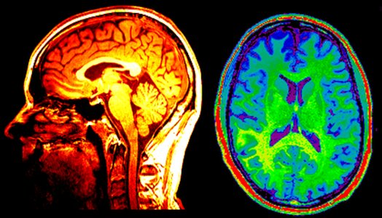
Can Neuroscience Access Consciousness?
Neuroscience provides access to the Easy Problem of Consciousness.
Tangible structures of the brain should be considered as possible symptoms of a deeper context which transcends and defines tangibility.
neuroscience IMPLICATIONS
Notes:
Since we can only use neuroscience to infer the presence of intangibles from our own direct experience, philosophical induction is leaky.

Slide 28
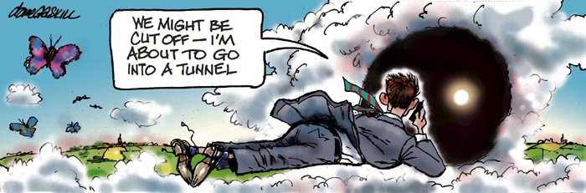
Transcendent Mind, Transcendent Sense
Phenomena such as NDEs, OBEs, telepathy, synchronicity, reincarnation and paranormal
experience cannot be ruled out a priori as being supernatural.
neuroscience IMPLICATIONS
Notes:
If we cannot rule out intangible causes and effects, we cannot rule out anomalies.

Slide 29
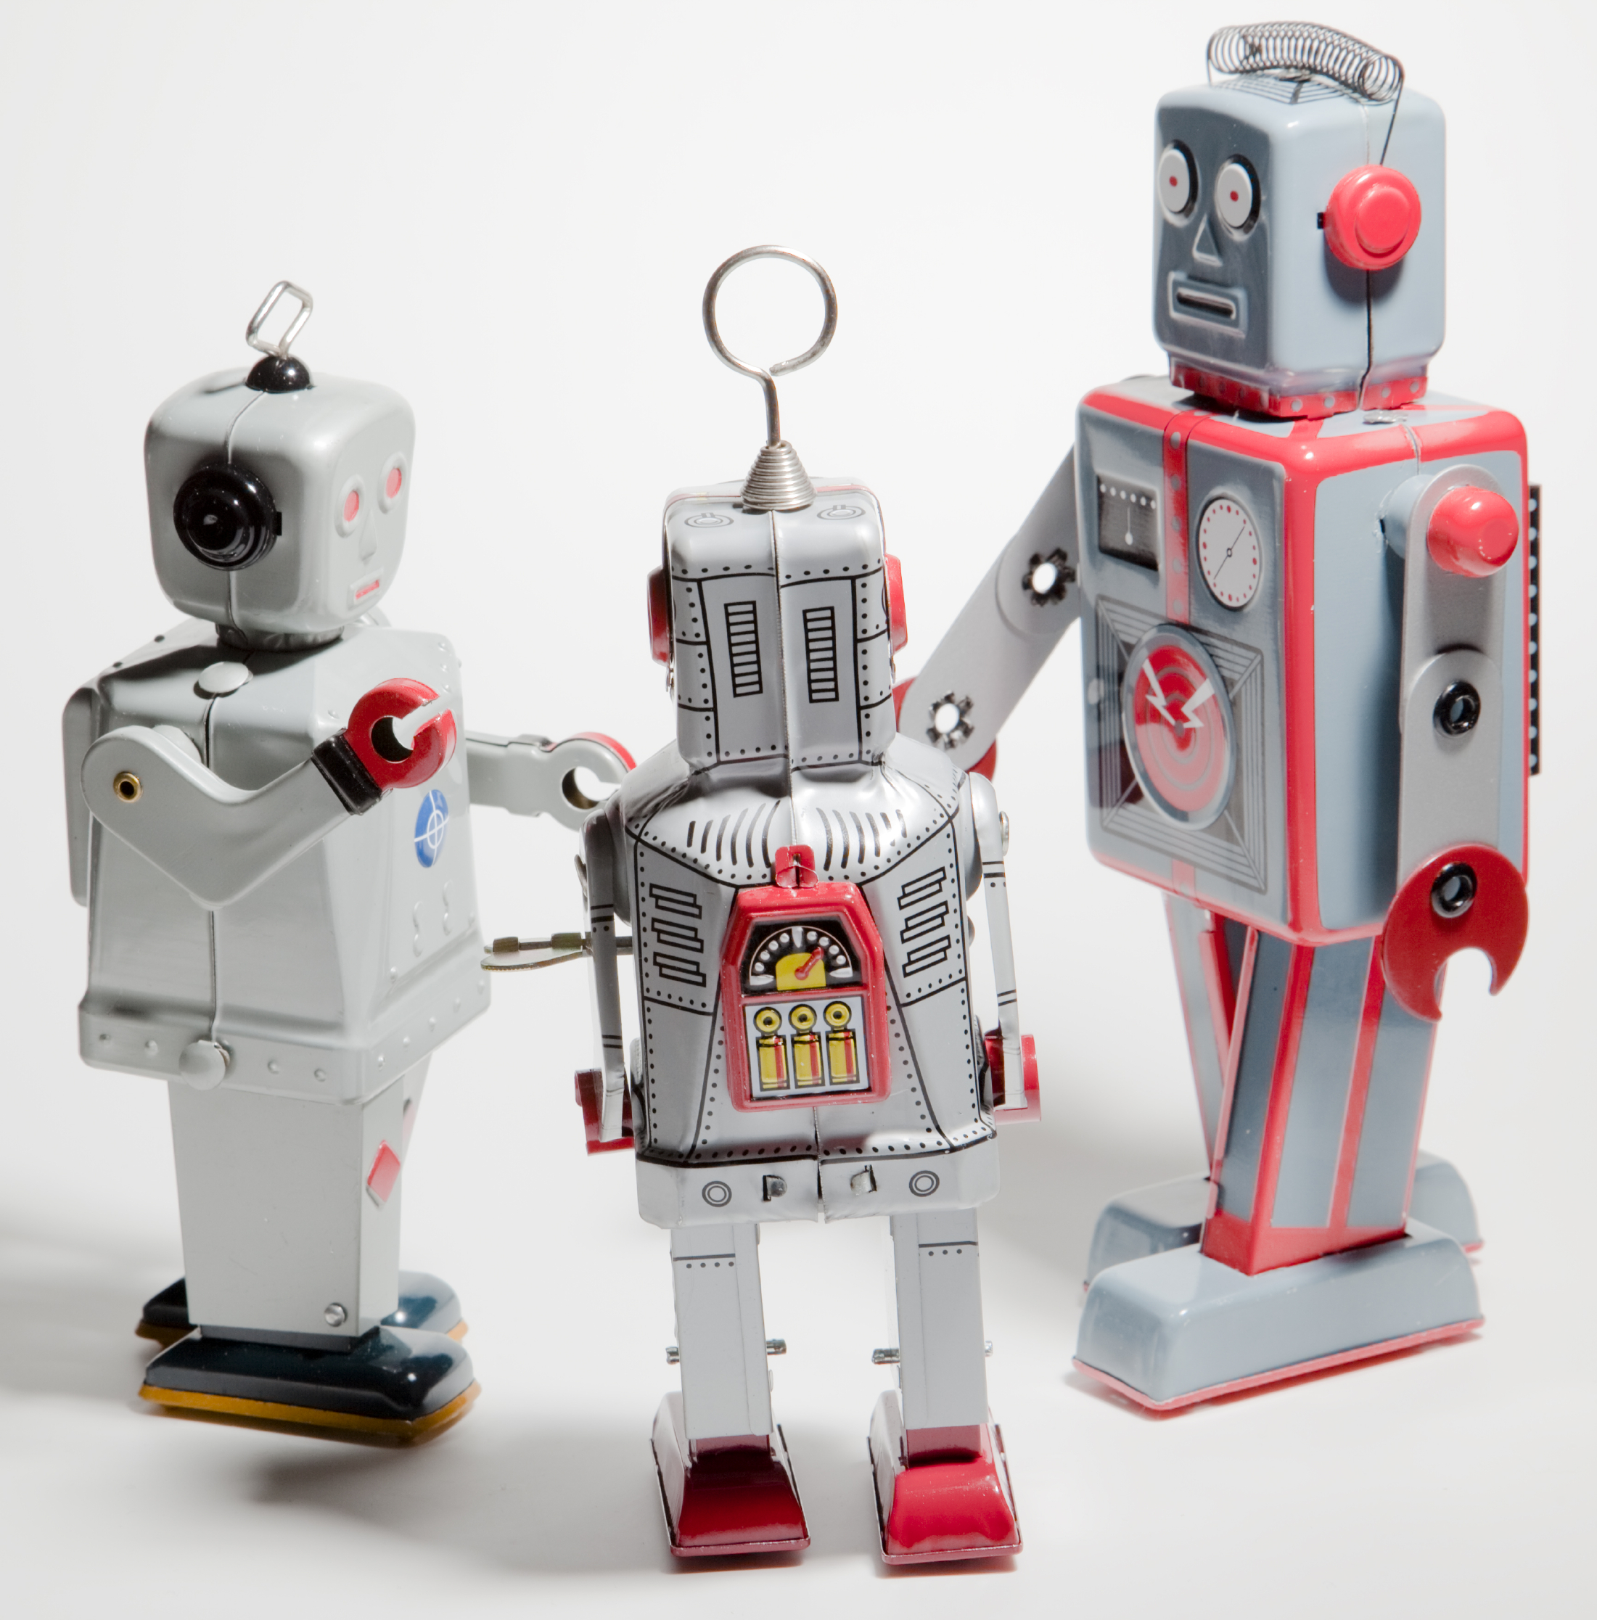
Simulated Intelligence or Technological Gnosticism
Computers may never develop intentions, awareness, or understanding of their own. There may be no singularity.
Attributing consciousness to computers may be an example of the pathetic fallacy, or it may open the door to new relations with the transpersonal.
AGI IMPLICATIONS
Notes:
AGI may not be possible. We will be guided and misguided by apophenia as well as prejudice.

Slide 30
Thank you
Craig Weinberg
multisenserealism.com
multisenserealism@gmail.com

